Slide 1
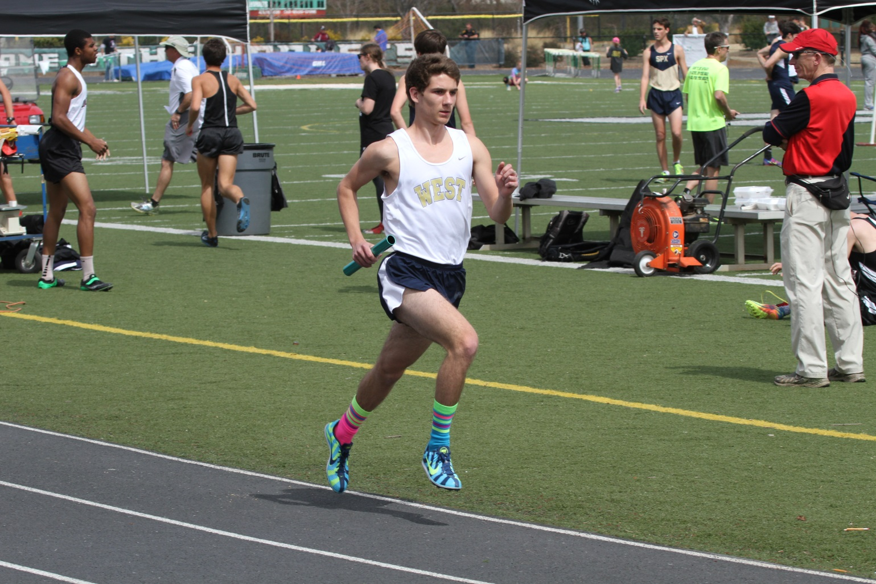
DISTANCE RUNNERS GUIDE TO TRACK
West senior Brett Gammon modeling ideal distance race form.

Slide 2
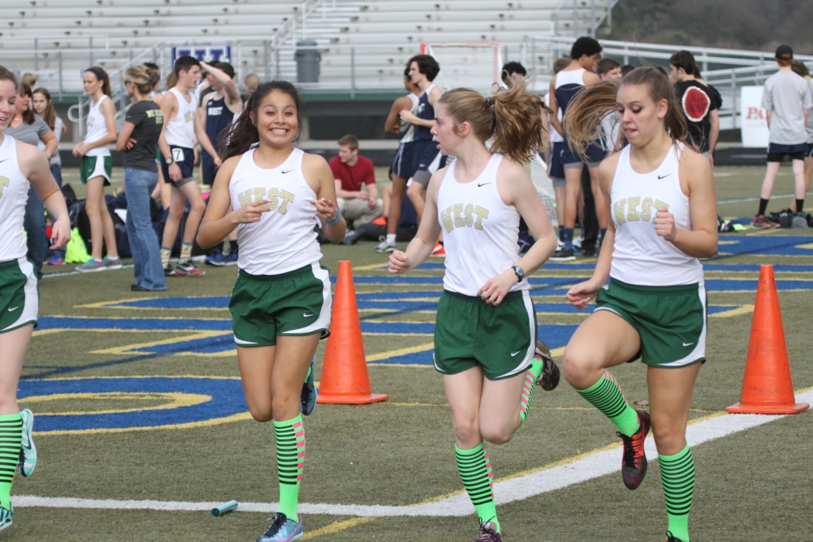
PREPARE TO RACE PROPERLY
Know when your race is in the meet schedule and plan out what you need to do before you race.
Execute a proper, timely & complete warm up including drills/striders. Never show up at the starting line without pre race prep.
Allow time for checking in for races & for putting on your spikes. Last minute panic is wasted energy.
Make sure you have looked after your hydration and food needs on long track meet days.
Have a smile in your heart and be excited.
A little nervous energy is good but don’t stay nervous for too long prior to your race.
Get in one last good strider right before the race to make sure your body is awake, muscles are engaged and ready to rip!
Take a few deep breaths. Shake out your arms and relax your upper body.
React to the gun and go to work.

Slide 3
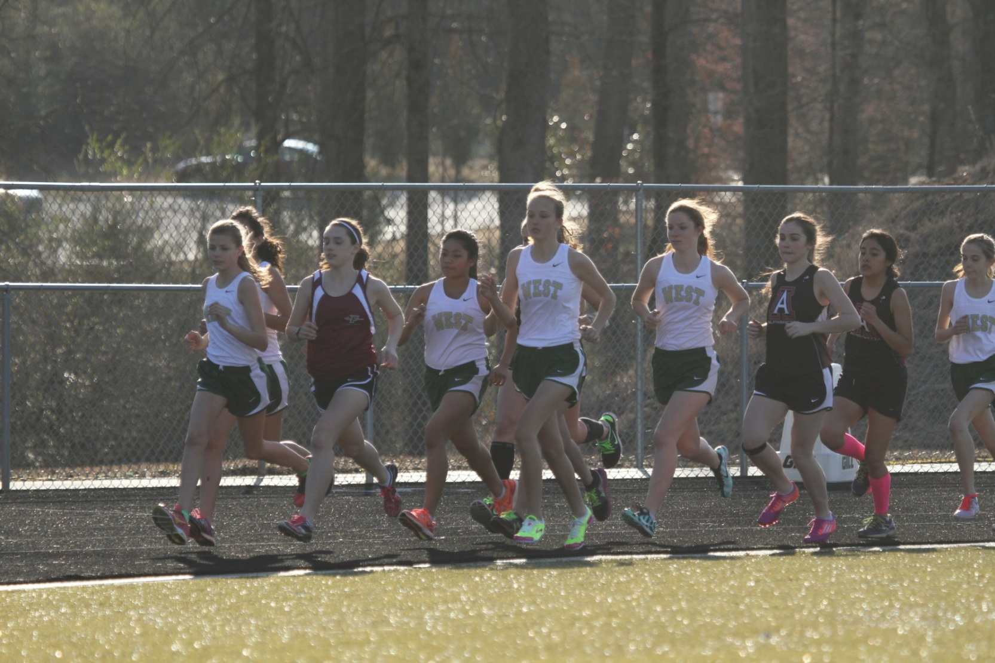
ESTABLISH POSITION EARLY
Be aware of your position relative to other runners throughout the 1st 1st 100M. Head on a swivel.
Run defensively. Hold your ground. Be aware of what runners around you are doing and react.
Don’t freak out over a little contact. Be ready, as needed, to use your hands to deal with a bump or two.
Don’t get stuck behind packs of runners that you know are better than. Passing takes energy.
Don’t go out more than a few seconds faster than even pace for lap 1, except in the 800M. Be calm.

Slide 4
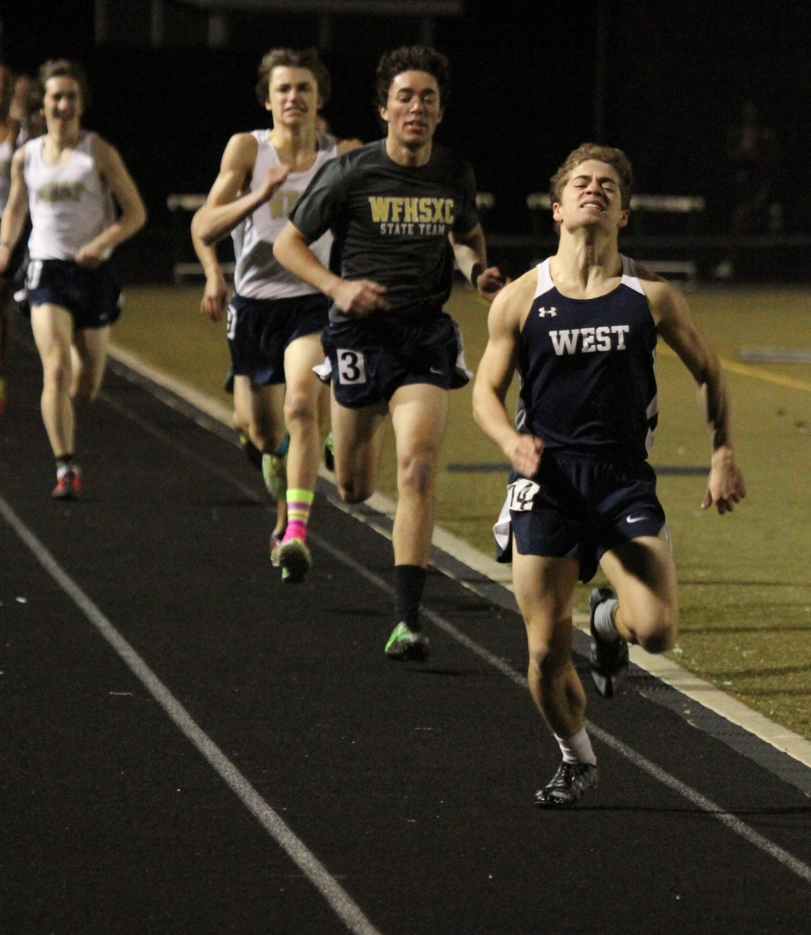
FORM – RELAXED IS FASTER | STRIDE RATE IS KEY!
Make a purposeful effort to relax your face, neck & shoulders any time you run, but especially in races and even when you kick. World class runners, even in the 100M, run this way and so should you!
Run tall! Upright body position helps you get deeper breaths and process more oxygen. Crouching and bending forward reduces your ability to fuel your body with the air its needs to perform at it’s best.
Straining feels right, but IT DOES NOT HELP YOUR SPEED.
Relaxed is faster. PERIOD. END OF DISCUSSION.
Don’t “reach/over-stride”. Get up on the balls of your feet. Your foot should land directly under your body. Keep your knees high. Pull your heal quickly back up to your butt. Think about “pawing” the ground like a B-skip.
Ideal turn over for any race is 180 steps / minute. Count your strides some time in workouts to see what rate you run. 180 steps/minutes is the tempo that elite athletes from the 800M to the marathon run. It is not the athlete with the longest stride who does best, it is the athlete who can maintain a tempo. Try to run 180 strides / minute, no matter what pace you are running. Do it in practice on easy days, in workouts and teach your body the right cadence to run in races.
Work to increase your stride frequency. Doing this will also lessen your vertical bounce, because the quicker steps force your body to stay closer to the ground. This lighter touchdown not only makes you faster but will also reduce impact, which is a major cause of running injuries.
When it gets hard, concentrate on your form. Run tall. Relax face, neck and shoulders. Be still….no extra upper body movement. Don’t over stride and keep stride rate high, targeting 180 / minute.
Josh Harrison, in 2nd, with a relaxed face while sprinting.

Slide 5
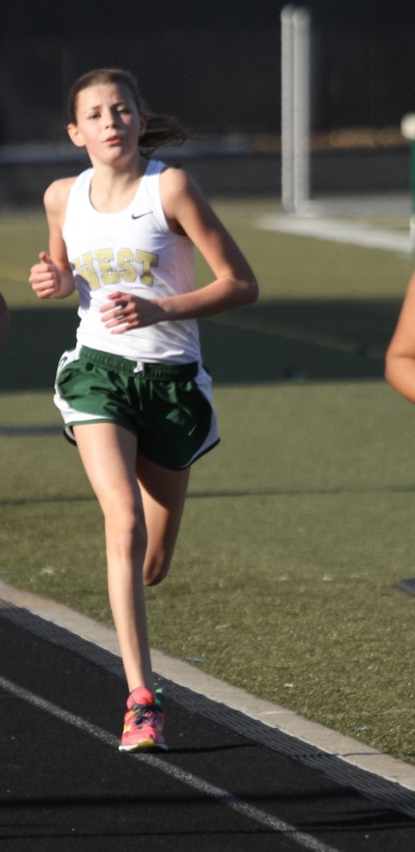
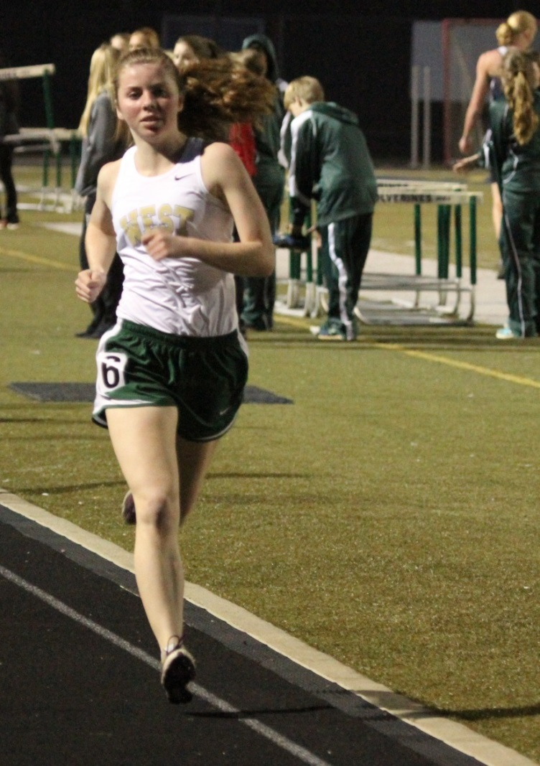
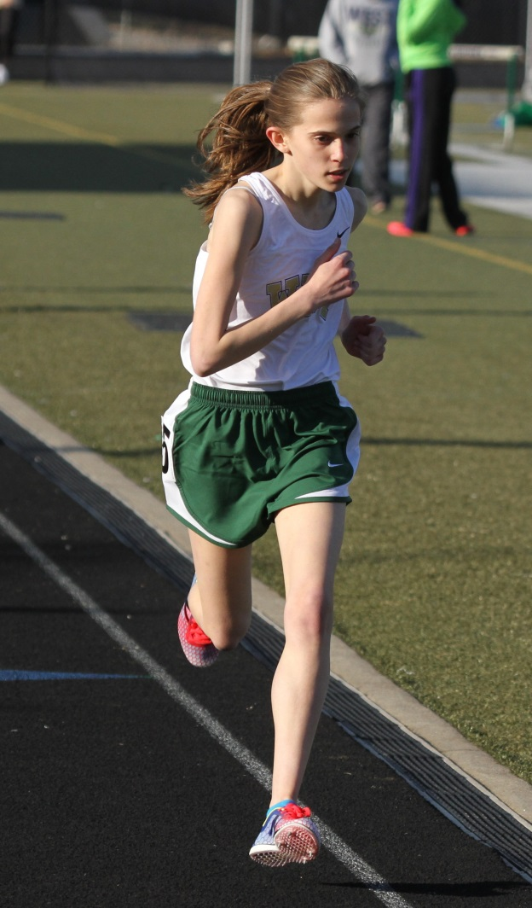
FORM – STILL, UPRIGHT UPPER BODY
Don’t rotate your upper body in an effort to increase stride length to run faster. Keep you head still and facing forward. Shoulders mostly square. In general you want a quiet upper body, with strong rhythmic arm movement driving you in a straight line forward.
Upper body should be still & upright. Any sideways torso twist, arm swing across the center line or forward lean is counter productive to running fast.
Doing side planks and other exercises that build a strong core and concentrating on quality warm up drills and lunges will strengthen your body, allow you to clean up your form and help you run more efficiently and ultimately race and sprint faster.
Strong athletic body types perform best in track distance running. Work on your body, in addition to logging miles, if you want to run your best.

Slide 6
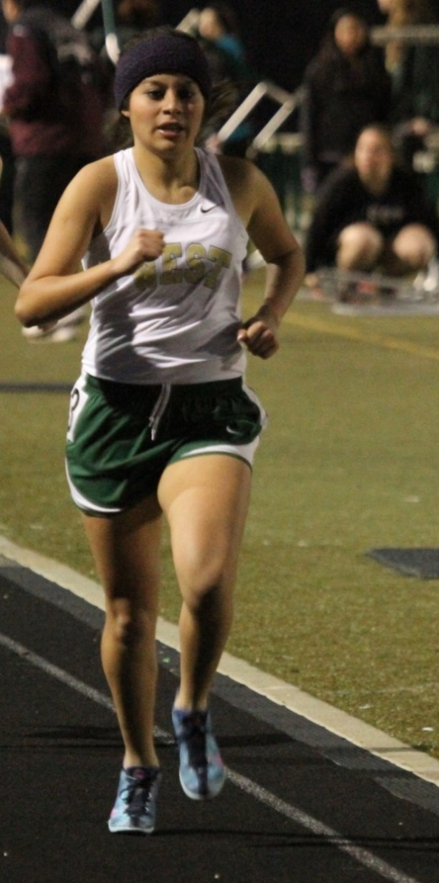
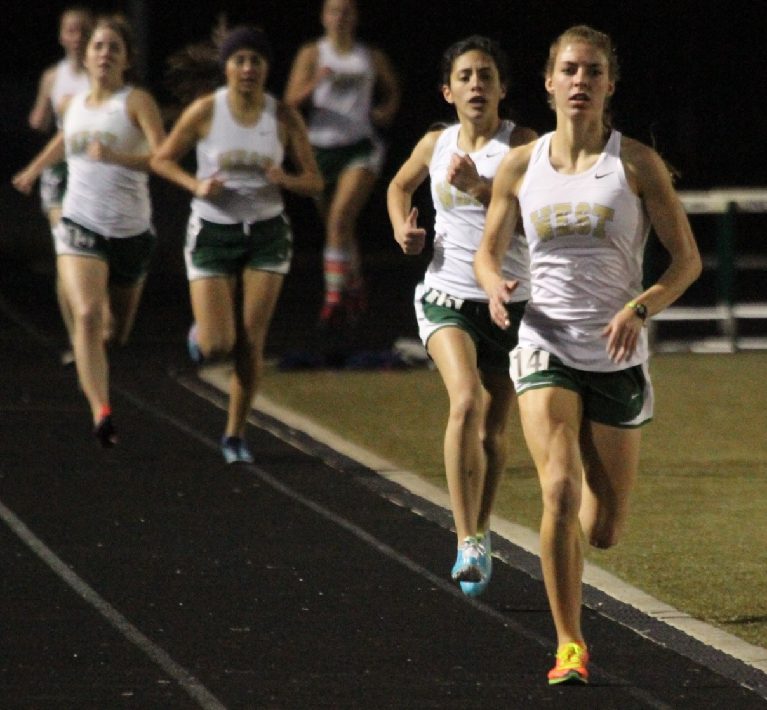
FORM – USE YOUR ARMS PROPERLY
Daniela Calderon, at left, with excellent arm position. At right, notice a few arms cross line of body
Arms set your tempo. Use them! Especially as you start to get tired & especially as kick at the race’s end.
Hand motion = hips to chest. Never cross over center line.
Use your arms to establish a nice race rhythm. Track races have a beat to them, like music. Feel the beat. Go with the flow.
Elbows straight back, close to your body. It is critical to get your elbows back. Think BACK, BACK, BACK
As Coach Tillery likes to say, “HANDS!, HANDS!”. Your feet follow your hands! Move your hands/arms faster and your legs will up the tempo in response.
When you feel like you are falling apart in the last few meters of a race, especially in the 800M, more aggressive arm action is the only thing that can save you.
Hands, whether in a little fist or open, should be relaxed, not clinched or rigid.

Slide 7
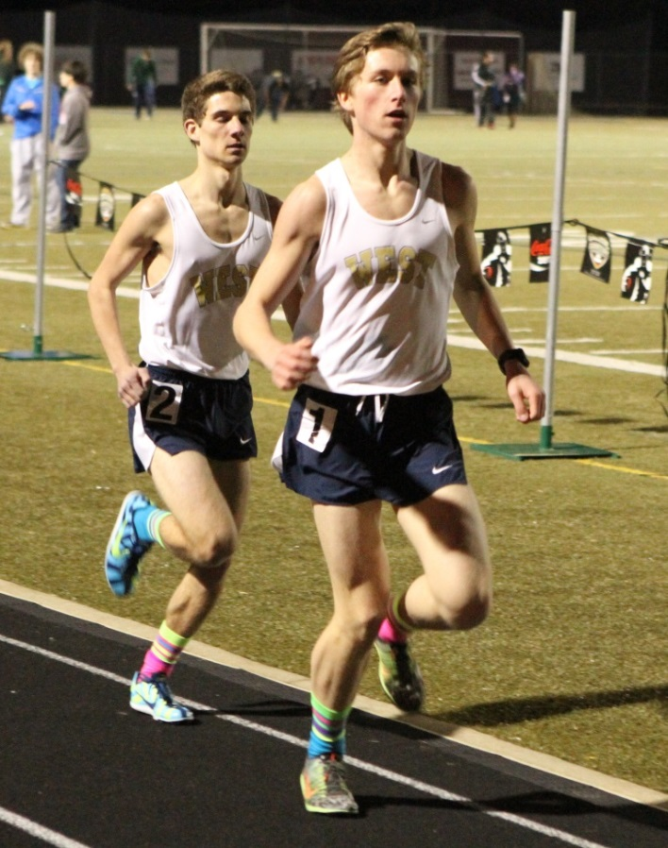
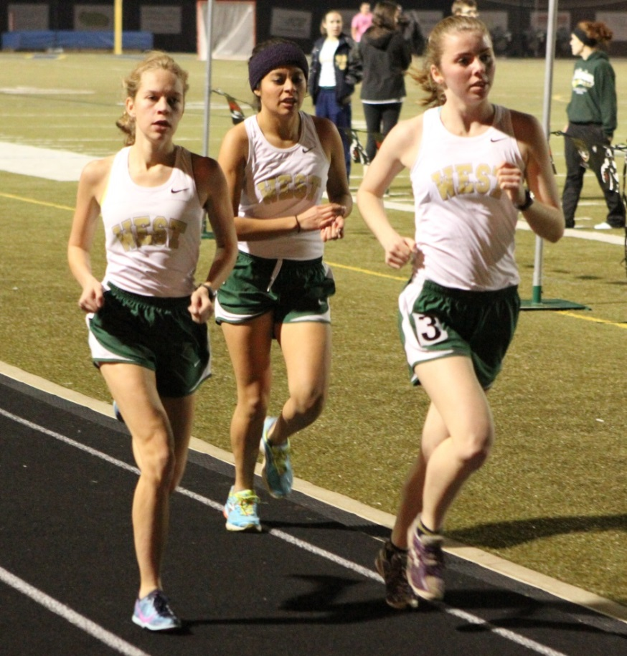
DRAFTING – TEAM RUNNING
Drafting directly behind another runner saves energy & increases speed up to 1 second per lap!
If you can draft behind someone running same pace, especially on a windy day, DO IT! Teammates working together can trade off leading laps to keep both runners physically and mentally refreshed. If you are running 5 meters behind someone don’t stay there. Close down the gap with a quick surge and draft! Practice leading and following during workouts.
It feels comforting to run on someone’s shoulder, but don’t run your race on the outside of lane 1 or inside of lane 2. Doing so makes you run 5-7M further per lap due to extra distance covered on curves. 25M/5-6 seconds in a 1600. 50M/10-12 seconds in a 3200M.
If you know someone is drafting on you an entire race you can…. do nothing and hope the advantage they get doesn’t make a huge difference in the last lap, put in one a small surge and see if you can drop them, or slow a little and force them to go around and lead so you can draft and rest up.

Slide 8
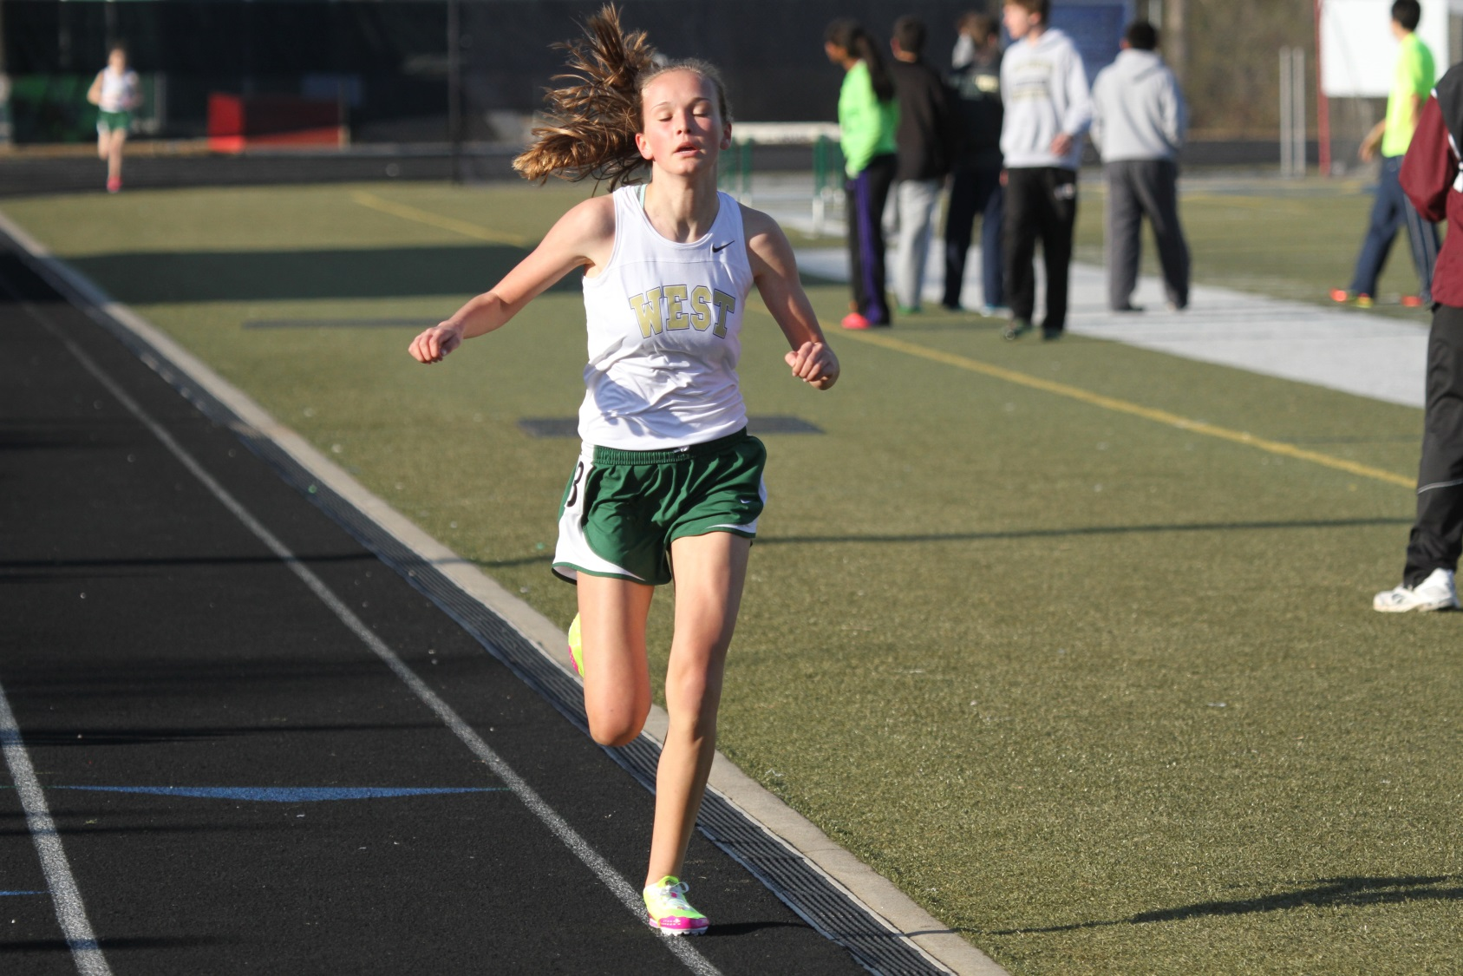
DO NOT RUN ON THE LINES
Stepping on the line will get you disqualified. Curve or straight.
Don’t touch the line even for one stride. It is cheating.

Slide 9
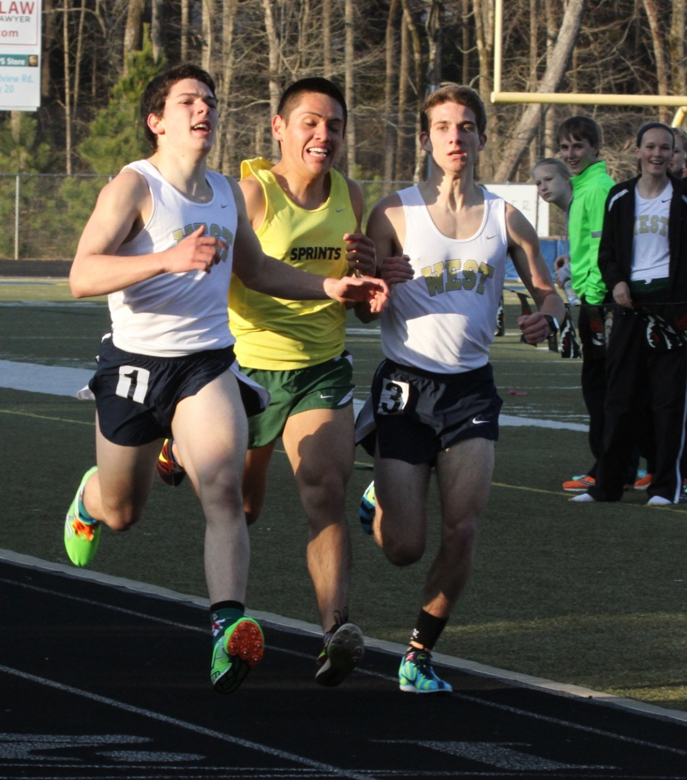
WHEN / HOW TO PASS
Pass when the person in front of you is running a pace slower than you are comfortable or capable of sustaining.
Almost never pass on the curve unless you are being slowed to the point where running extra distance is worth it.
Ideally, pass right before entering a turn or just after a turn. Hold someone off trying to pass you just before a turn so if they do pass, they have to run longer.
You must be a full stride clear a runner before you move back in front during a pass. If you cut over too soon and impede the other runner’s progress you may be disqualified.
Don’t try an inside pass unless someone has drifted to the outside of lane 1 and then be prepared if they move in to close you off or if they move out to keep you from coming around.
Avoid contact.
Sitting on another runner and outkicking them is a good strategy if you have superior speed but when you go, make your move decisive.
Jonathan Gomez with no room to pass. Good chance of a DQ.

Slide 10
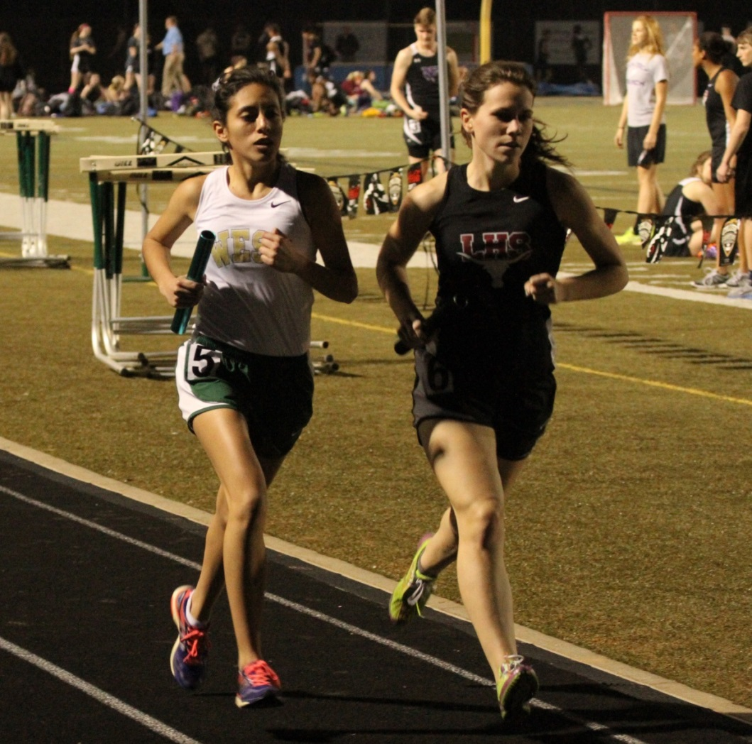
KEEP YOUR HEAD IN THE RACE
Track is about competition much more than it is about times. Places are what score points for your team, not times. Places are what qualify you for finals, not times. Places are what qualify for sectionals and state, not times.
Given that, use the other competitors to help you tap into courage and mental strength that will help you perform. Distance running is 50% physical and 50% mental. The faster person does not always win. BELIEVE!
If you are chasing a runner, set goals to close the gap on them a little at a time, a little each 200 or lap. If you have several runners ahead of you, set a mid race goal on how many runners you intend to pass before the race is over. Count strides between you and the person you are chasing and gain confidence at the number declines.
Keep your eyes up and look at the back of the runner in front of you. If you look down at the track, your mind disconnects from the competitive nature of a track race and you will slow down. Looking at a runner in front of you inspires you to maintain contact and/or gain ground on them. Looking at the track is a form of mental defeat. Don’t do it. EYES UP!
If someone passes you and is running a similar pace, latch on to their back. If they pass you with authority, any time other than in the last 400, don’t panic and be patient. Super hard surges in track races take a toll and this athlete may come back to you later on in the race. You don’t have to react to every move.
The 3rd 200M in the 800M, 3rd 400 in the mile and 3rd 800M in the 3200M is when EVERYONE struggles. If you want to gap someone or break someone you know has a better kick… do it then. Pushing during this segment is hard but all champions do it. Mind over matter.
Don’t panic about splits and places during competition. A positive mental attitude in a race is your best ally. If you let your brain start negative self talk, you are done….. even if your body is capable of more. If you think you can’t, YOU WON’T!

Slide 11
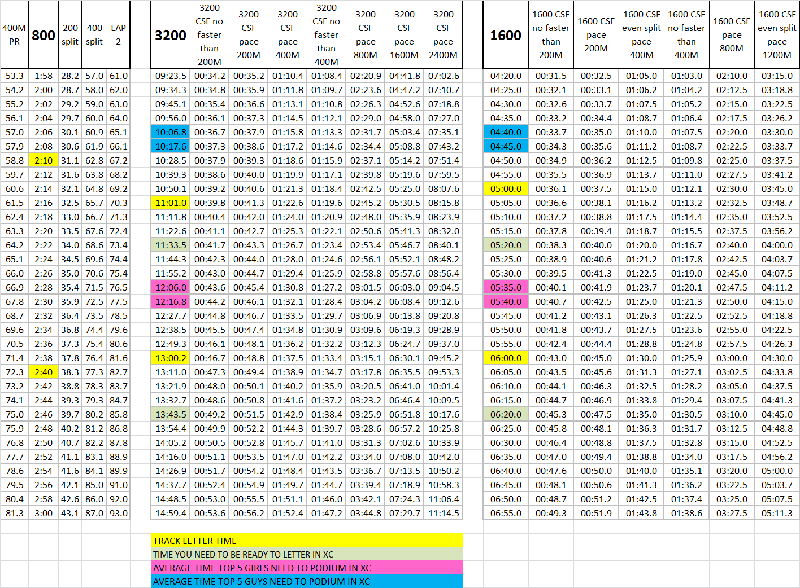
Race pace charts
Various race times and paces are available in this chart.
The times across each row are “roughly” equivalent performances. They will vary some by athlete depending upon whether you are more of a “speed” runner or an “endurance” runner.
Even splits are best for 1600 & 3200M races with a faster last 400M.
In the 800, the first lap should be 4-6 seconds faster than lap #2.

Slide 12
RACE TACTICS
400M
The first 50-70 meters should be a fast acceleration: USE IT OR LOSE IT. This acceleration should be near max speed (closer to 95-97%). The reason being is that once the creatine phosphate is used (which is stored in the muscles, and only dispersed for about 4-5 seconds), there is no more left. Hence the term, use it or lose it. It's important to get your speed up to near max to create as much momentum for the backstretch phase of the race.
Once the runner reaches the 50-70 meter mark on the first turn he/she needs to stop pushing as if they were running a 100m race. At this point the runner should try to relax and maintain what they have built up during the acceleration phase. As you transition from 97% and relax, it does not mean slowing down, you are simply not pressing anymore. The first 200m split should be close to a second slower than their open 200m time. At this point the runner mentally prepares for the end of the race.
You may find it helps to start taking deep breaths even before you feel you need to. The first part of the 400 happens so quickly, that your body won't even realize it needs to be taking in more oxygen until it gets to about the 150 meter mark, so starting to breathe early can prepare you for the more difficult second half of the race.
Try to maintain your speed in the 3rd 100. By the time the runner gets to the 100m to go mark, it's the "prayer" part of the race because at this point all you can do is pray and hope that your training will allow you to finish the race. In the home straight, the key is to maintain form. When you enter the straight you should be running at your top speed - you can't accelerate any more.
If you are running a good race, you will feel like you are struggling to run, and your hands/arms may even go numb. If you don't feel like you are struggling in the home stretch, then you didn't run the first 300 meters fast enough! The interesting thing about fatigue in the home stretch of the 400 is that feeling tired does not mean that you are slowing down. Rather, feeling tired indicates that you're continuing to put forth the even effort that you put forth during the first 300 meters. Keep your eyes looking straight ahead (not up at the sky, which feels natural when you're tired), and keep your arms moving back and forth. Run all the way through the finish line, and then you're done!.
1600M/3200M
The 1600M and 3200M races, are best run with even pacing. Your fastest lap on the last one with a solid gear change or too.
Most high school races are NOT run in this manner. The first and last lap are usually faster and the middle laps are slower with similar split times. For the 1600M & 3200M, middle laps end up being 5-6 seconds slower than the 1st and last lap.
1st lap is typically fastest in the 1st 200M as everyone is excited and trying to establish position. While its NEVER a good idea in a distance race to start out too fast in the first part of the race, it is OK to be a little quick in your opening 200M if (and really only if) this is required to keep you from being pushed behind a large pack that you will eventually have to waste energy later on to pass. Remain calm and run your own pace. Run the pace YOU can maintain to the end of the race.
Tempo and turn over are key in the middle laps. Run fast and relaxed and let your body do what you are teaching it to do at practice on interval days. Keep your head in the race, compete and don’t let your mind drift. Don’t give into that little voice that tries to tell you it’s OK to slow down or that you can’t do it. That little voice LIES. TELL IT TO SHUT THE HECK UP BECAUSE YOU HAVE WORK TO DO!
Finish! Be brave. Start your kick earlier than you think you can. He who kicks first and who maintains their form best usually finishes best.
800M
The 800M is one of the most difficult races to run as an ideal race pace feels pretty close to a sprint the entire race.
Unlike most longer distance races, the perfect 800M race does not involve establishing an early position and pace and then accelerating at the end.
Pace for lap #1 is roughly 5 seconds slower than you can run an all out 400M race. The fastest portion of your race should be the 1st 200M on lap #1 but it will feel the easiest since you are running off of adrenaline and you haven’t challenged your bodies oxygen needs yet. Get out hard and break for the pole clean paying attention to the other runners and establishing a position that gives you space to run. If you are more of a 400M type runner, you will likely want to go to the front, using your natural speed to establish position and drag the distance types out faster than they are comfortable running and/or creating a gap.
For more distance type runners, don’t get caught up going out so fast that you get yourself in over your head. Your advantage is the 2nd lap when your strength becomes an ally. In large tight fields, try to avoid being trapped and boxed in on the rail so you have no ability to make moves as needed. When the 400M type guys and the runners who went out too fast start to tie up and slow down, you need space to get around them without have to check up your momentum.
Whether you are a sprinter type or a distance type, effort level remains constant on lap #2 and your pace will fall off just a little as your body is unable to sustain the same pace. The 3rd 200 starts to hurt.
Final 200M requires additional effort to maintain speed. In the 800M, the finish, like in the 400M, is not usually about who can go faster, it is about who can maintain their form and slow down the least.
Run hard THROUGH the finish line and NEVER GIVE UP in the last part of the race. In this race, more than most, positions OFTEN change place in the last 20 M.

Slide 13
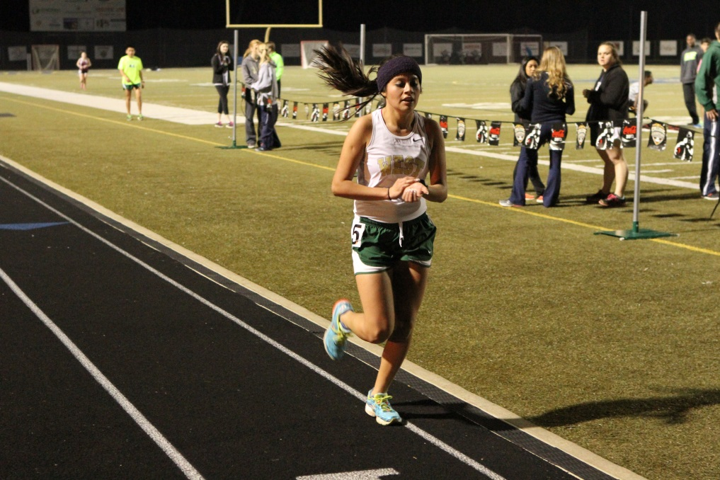
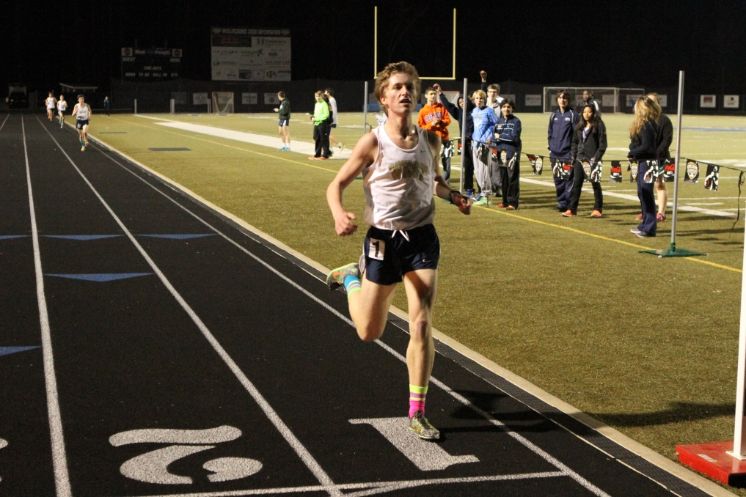
FINISHING
Nothing is more important in track than how you finish races. It’s the key to getting the best place and running the fastest time.
Changing gears requires you to run like a sprinter. This is why we do form running drills, the point behind much of our weight room work with coach Z and why we will work in sprinting form during striders and faster intervals at practice. The entire point of striders is to work on your fast running form.
Pretend the finish line is beyond the actual finish and sprint your guts out through the line! Kicking is 90% mental although it feels 90% physical. It is, at it’s essence, about WANT TO. There are only two kinds of runners at the end of any race, runners what WANT TO and are mentally strong enough to force their body to sprint and runners who are mentally weak and GIVE UP AND QUIT. Your body can do it. Trust me on this. Which kind of runner do you want to be?
Please trust your training and your body and try to shift gears earlier than you do now. If you currently wait for the last 50, try the last 75. If you go coming off the final curve, start at the middle of the curve. Ideally, 3200 and 1600 runners will ALL have a gear change with 400 to go and at 200 to go once it gets to be championship season. You may assume that the best of the best all have a gear change in the last lap and won’t wait for the last 50.
One good finishing strategy is to start your kick at a predetermined spot.. 100, 150, 200, 300, 400 out. Decide ahead of time and then execute. Otherwise, your brain will coax you into waiting for the last 50, which generally is too late. Teaching your body how to recruit fast twitch muscles fibers and sprint in track will pay dividends to you and your team in cross country. Don’t forget. HANDS! HANDS!
Don’t worry about stopping your watch. Most races we do are fully automatically timed so you will get your results.
If you want your race splits, get a friend to capture them and / or call them out. You should be using your arms aggressively at the race finish, NOT using them to stop your watch! Messing with your watch at the finish will cost you precious time and could cost you an important place.

